Slide 1


Anonymous Complaint System
SACHIN KUMAR JHA
IF21027

Slide 2

Introduction
The Problem: Traditional complaint methods (paper forms, in-person reporting) in educational institutions are inefficient, lack transparency, and fail to ensure the confidentiality of complainants.
The Barrier: While some digital systems exist, many do not guarantee the anonymity of the users, which prevents students and staff from reporting sensitive or personal issues.
The Functional Gap: Existing systems often lack robust, comprehensive features necessary for efficient complaint resolution, tracking, and detailed management reporting.
The Project Goal: To develop a new, anonymous complaint-based website that provides a confidential, streamlined, user-friendly, and fully integrated approach to addressing all staff and student concerns.

Slide 3

Applicability
Directly improves college complaint management: The anonymous system offers a safer and more efficient way for students and staff to report issues, directly benefiting the college community
Serves as a model for other schools: The project provides a blueprint for other educational institutions looking to adopt or improve their own complaint management systems.
Showcases modern web development: It acts as an excellent case study demonstrating current technology and design principles for future web development initiatives.

Slide 4

achievements
Improved Complaint Handling: The project aims to enhance the efficiency and confidentiality of complaint handling at the college.
Enhanced User Experience: Users will have a user-friendly platform to submit their complaints.
Data-Driven Decision-Making: The system will provide valuable data and insights for informed decision-making.
Contribution to Best Practices: The project may serve as a reference for other educational institutions seeking to modernize their complaint management systems.

Slide 5

Web-Based Interface, Anonymous Submission, Management, User Security
HTML5 and CSS3: Fundamental for creating the website's advanced structure and styling.
JavaScript and jQuery UI: Advanced UI libraries for creating advanced user interfaces.
Chart.js: Displaying various charts for complaints received and managed. Back-end Technologies:
Backend-PHP, mySQL, AES encryption
<Insert pictures or drawings of your invention design/building process>
*you can insert a new slide for these pictures/drawings if you need to!

Slide 6
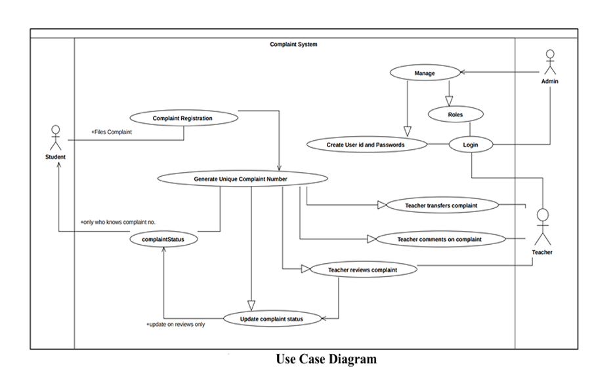
Use Case Diagram

Slide 7
Thank you

